Slide 1
Introduction utilization of electrical energy

Slide 2
WHAT IS ELECTRIC HEATING ?
WHAT IS THE PRINCIPLE BEHIND IT ?
Electric heating is any process in which ELECTRICAL ENERGY is converted to “HEAT ENERGY”.
Electric heating works on the principle of ”JOULE HEATING” (an electric current through a resistor converts electrical energy into heat energy.)

Slide 3
INTRODUCTION
Electrical heating is based on the principle of that
when electric current passes through a medium
heat is produced. Let us take the case of solid
material which as resistance ‘R’ ohms and current
flowing through it is I amps for ‘t’ seconds than heat
produced in the material will be H=I²Rt Joules.

Slide 4
DOMESTIC APPLICATION OF
ELECTRICAL HEATING
Room heater for heating the building
Immersion heater for water heating
Hot plates for cooking
Geysers
Electric kettles
Electric Iron
Electric oven for baking products
Electric toasters etc…

Slide 5
INDUSTRIAL APPLICATION
Melting of metals
Electric welding
Mouldling of glass for making glass appliances
Baking of insulator
Mould ling of plastic components
Heat treatment of pointed surpasses
Making of plywood.

Slide 6
ADVANTAGES OF ELECTRICAL HEATING OVER OTHER METHOD OF HEATING
Clean and atmosphere / Free from dirt.
No pollution / No flue gas is produced
Response quickly
Accurate Controlled temperature can made easily
Comparatively safe
Localized application
Overall efficiency is much higher
Uniform heating
Highest efficiency of utilization
Cheap furnaces
Mobility of job

Slide 7
TRANSFER OF HEAT
Conduction:- This phenomenon takes place in solid, liquid and gas.
Heat transfer is proportional to the difference of temperatures between two faces.
No actual motion of molecules.

Slide 8
Convection
This phenomenon takes place in liquid and gas. Heat is transferred due to actual motion of molecules
Radiation
This phenomenon is confined to surfaces. Radiant energy emitted or absorbed is dependent on the nature of the surface.

Slide 9
CLASSIFICATION OF ELECTRICAL HEATING
Power Frequency heating High Frequency heating
Resistance heating 1. Induction heating
Direct Resistance heating a. Direct Core type
b. Indirect Resistance heating b. Core less type
Arc heating 2. Dielectric heating
Direct Arc heating
Indirect Arc heating

Slide 10
Classification of Heating Method:-
Low Temperature Heating ± up to 400°C
Medium Temperature Heating ± from 400°C to 1150 °C
High Temperature Heating ± above 1150 °C

Slide 11
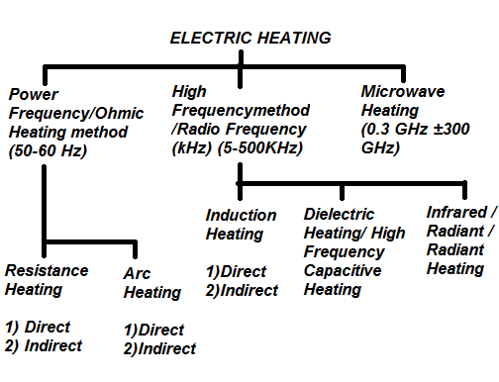

Slide 12
Characteristics of Heating Elements
1) high resistivity
2) able to withstand high temperatures without deterioration
3) low temperature coefficient of resistance
4) positive temperature coefficient of resistance
5)free from oxidation at high temperatures

Slide 13
RESISTANCE HEATING
(Example – Electric Water Heater)
This method is based upon the I²R loss.
Whenever current is passed through a
resistor material heat is produced because
of I²R losses.
The generation of heat is done by electric resistor carrying current.

Slide 14
RESISTANCE HEATING
  DIRECT HEATING
  Electric current is passed through the body (charge) to be heated.
  High efficiency
  Mode of heat transfer is Conduction
  Example-
  1) Electrode boiler for heating water
  2)Resistance Welding
INDIRECT HEATING
Electric current is passed through highly resistive material(heating element) placed inside an oven.
Heat produced due to I²R loss in the element is transmitted to the body
Mode of heat transfer is Conduction &/or Convection &/or Radiation
Example-
1) Room Heaters
2) Domestic & commercial cooking
3) Heat treatment of metals

Slide 15
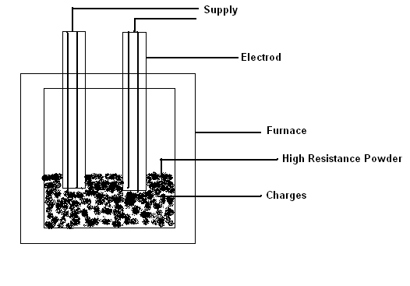
1. DIREDCT RESISTANCE HEATING
KUMAR CHATURVEDULA

Slide 16
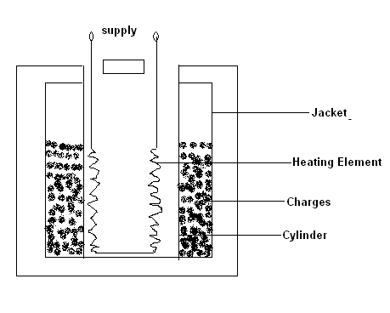
2. INDIRECT RESISTANCE HEATING
KUMAR CHATURVEDULA

Slide 17
CAUSES OF FAILURE OF HEATING ELEMENTS
Formation of hot spots.
Oxidation
Corrosion
Mechanical failure
KUMAR CHATURVEDULA

Slide 18
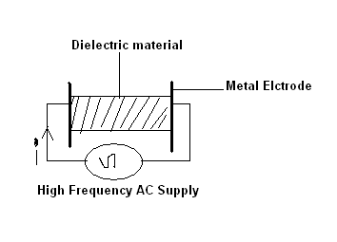
DIELECTRIC HEATING
KUMAR CHATURVEDULA

Slide 19
Dielectric Heating
Dielectric heating, also known as electronic heating, RF heating, high-frequency heating and diathermy.
Dielectric heating is a special way of transforming electric current into heat.
By the method of dielectric heating, generally, foils, plates and profiles with a thickness of 0,1-2,0 mm is are welded.

Slide 20
Dielectric Heating (contd…)
We understand dielectric heating as the generation of thermal energy (heat) in a non-conducting material by the application of an electromagnetic force or field t it. This is the way a microwave oven heats things placed in it.
KUMAR CHATURVEDULA

Slide 21

KUMAR CHATURVEDULA

